Slide 1


CHRONIC KIDNEY DISEASE ANALYSIS
Team Mates:
Soumya Thammishetty (Team Leader)
Bhagya Laxmi Kotte
Yamini Ramarapu
Navya Kondapaka
Chandana Sadineni
Guided by:
Pradeepthi Mam

Slide 2
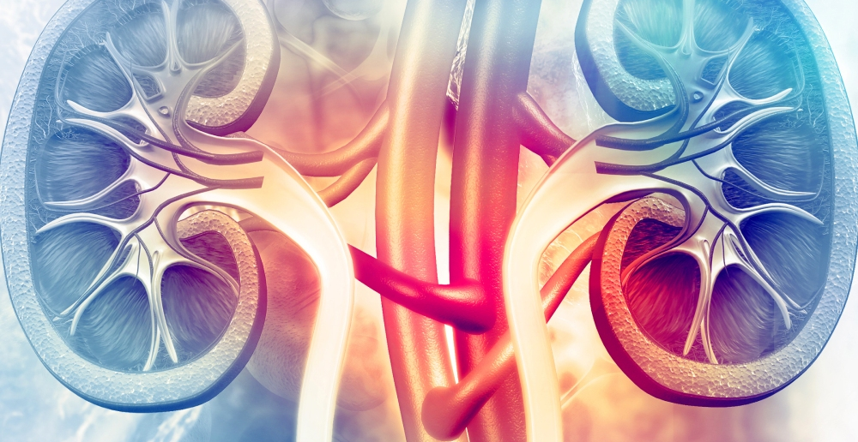
AGENDA
Introduction
Symptoms
Causes
Prevention
Treatment
Complications
Block Diagram
Experimental Analysis
Source code
Future scope
Summary

Slide 3
INTRODUCTION
Chronic kidney disease, also called chronic kidney failure, describes the gradual loss of kidney function. Your kidneys filter wastes and excess fluids from your blood, which are then excreted in your urine. When chronic kidney disease reaches an advanced stage, dangerous levels of fluid, electrolytes and wastes can build up in your body.
In the early stages of chronic kidney disease, you may have few signs or symptoms. Chronic kidney disease may not become apparent until your kidney function is significantly impaired.
Treatment for chronic kidney disease focuses on slowing the progression of the kidney damage, usually by controlling the underlying cause. Chronic kidney disease can progress to end-stage kidney failure, which is fatal without artificial filtering (dialysis) or a kidney transplant.

Slide 4
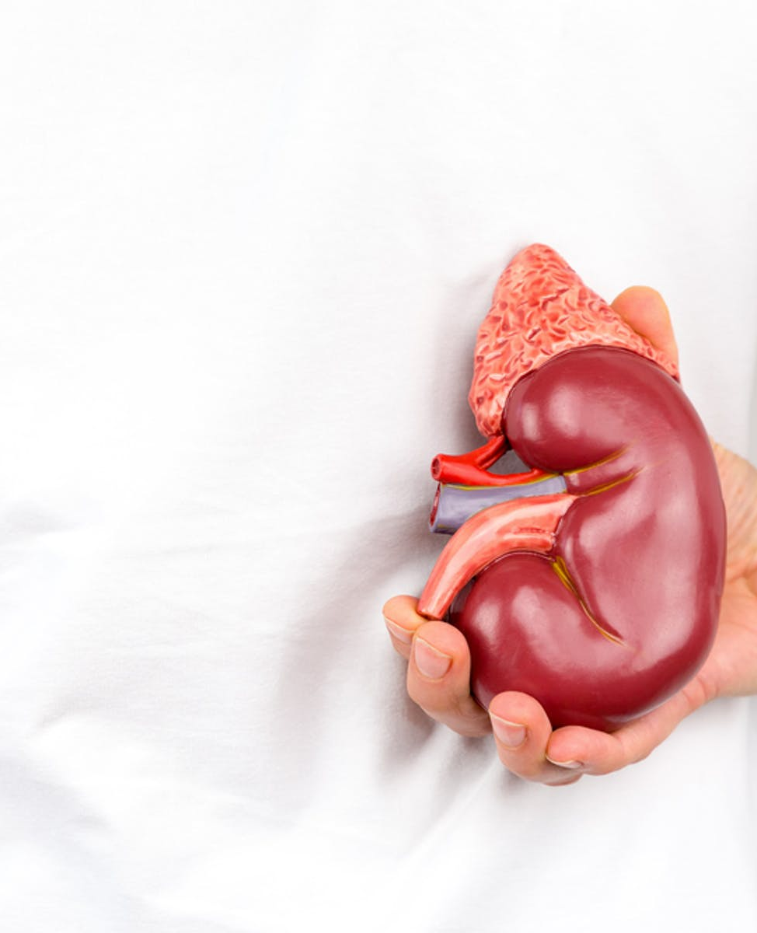
SYMPTOMS
chest pain
muscle cramps
nausea
shortness of breath
sleep problems
dry skin
itching or numbness
feeling tired
weight loss
increased or decreased urination

Slide 5
CAUSES
Diseases and conditions that cause chronic kidney disease include:
Type 1 or type 2 diabetes
High blood pressure
Glomerulonephritis , an inflammation of the kidney's filtering units (glomeruli)
Interstitial nephritis, an inflammation of the kidney's tubules and surrounding structures
Polycystic kidney disease
Prolonged obstruction of the urinary tract, from conditions such as enlarged prostate, kidney stones and some cancers
Vesicoureteral reflux, a condition that causes urine to back up into your kidneys

Slide 6
PREVENTION
To reduce your risk of developing kidney disease:
Follow instructions on over-the-counter medications. When using nonprescription pain relievers, such as aspirin, ibuprofen (Advil, Motrin IB, others) and acetaminophen (Tylenol, others), follow the instructions on the package. Taking too many pain relievers could lead to kidney damage and generally should be avoided if you have kidney disease. Ask your doctor whether these drugs are safe for you.
Maintain a healthy weight. If you're at a healthy weight, work to maintain it by being physically active most days of the week. If you need to lose weight, talk with your doctor about strategies for healthy weight loss. Often this involves increasing daily physical activity and reducing calories.
Don't smoke. Cigarette smoking can damage your kidneys and make existing kidney damage worse. If you're a smoker, talk to your doctor about strategies for quitting smoking. Support groups, counseling and medications can all help you to stop.
Manage your medical conditions with your doctor's help. If you have diseases or conditions that increase your risk of kidney disease, work with your doctor to control them. Ask your doctor about tests to look for signs of kidney damage.

Slide 7
TREATMENT
The main treatments are:
lifestyle changes – to help you stay as healthy as possible
medicine – to control associated problems, such as high blood pressure and high cholesterol
dialysis – treatment to replicate some of the kidney's functions, which may be necessary in advanced (stage 5) CKD
kidney transplant – this may also be necessary in advanced (stage 5) CKD

Slide 8
COMPLICATIONS
Your kidneys help your whole body work properly. When you have CKD, you can also have problems with how the rest of your body is working. Some of the common complications of CKD include anemia, bone disease, heart disease, high potassium, high calcium and fluid buildup
Gout.
Anemia
Metabolic acidosis
Secondary hyperparathyroidism

Slide 9
Bone disease and high phosphorus (hyperphosphatemia)
Heart disease
High potassium (hyperkalemia)
Fluid buildup

Slide 10
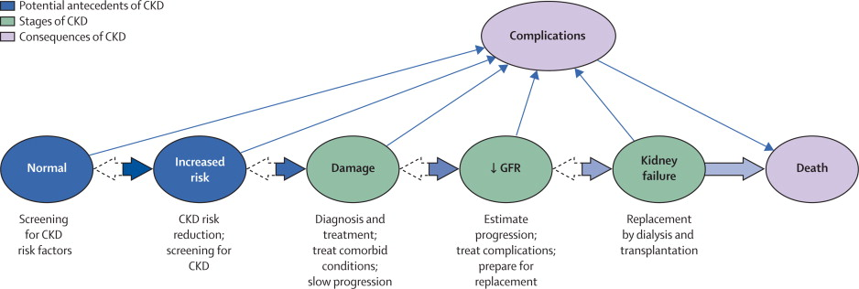
BLOCK DIAGRAM

Slide 11
EXPERIMENTAL ANALYSIS
In experimental kidney disease, there is an association between an increase in dietary protein and a higher blood pressure, and lowering dietary protein has been effective in reducing systemic arterial pressure in mineralocorticoid-induced hypertension in rats (165). In other forms of experimental hypertension, dietary protein restriction has not been so clearly associated with a reduced systemic pressure. The systemic hypertension that develops in rats following subtotal nephrectomy or in the two-kidney, one-clip renovascular hypertension model persists even when dietary protein is severely restricted (523, 625). In several models of CKD, dietary protein restriction diminishes renal injury, but there has been no consistent decrease in blood pressure, indicating that the beneficial side effects of protein restriction do not necessarily depend directly on reducing salt or eliminating some unidentified factor or compound that raises blood pressure.
Similarly, for humans with essential hypertension, there is no clear cause-effect relationship between protein intake and arterial pressure (649). Notably, when adults with CKD and hypertension are examined, systemic blood pressure has not been consistently reduced by restriction of dietary protein intake, similar to the results found in rats with CKD from subtotal nephrectomy (299, 354, 603, 606, 735)

Slide 12
EXPERIMENTAL ANALYSIS
The caveat is that a high-protein diet is generally associated with a high salt intake, and this could certainly raise the blood pressure of hypertensive CKD patients. DASH diets provide a test of dietary protein intake and hypertension independent of sodium. While low in meat, DASH diets are relatively rich in vegetable and dairy protein, so that overall they do not represent a significant protein restriction. Raising the vegetable and dairy protein content of a DASH diet does not impair the effect on blood pressure lowering (33). These data suggest that in hypertensive subjects with normal GFR, other dietary components can more than compensate for any possible adverse effects of dietary protein on blood pressure. The observation that the role of dietary protein on blood pressure in CKD appears to increase as GFR falls (480) suggests that either alterations in diseased nephrons create sensitivity to dietary protein or that other dietary-derived compounds accumulated in CKD (e.g., phosphorous, acid, uric acid, or other uremic toxins) cause hypertensive effects. Of these compounds, uric acid is most clearly associated with hypertension

Slide 13
.
SOURCE CODE
For the result of the project or code please click on below link
https://colab.research.google.com/drive/120OOYH1jYnqCBi3cL9AJmRjoyv9knZJ_?usp=sharing

Slide 14
FUTURE SCOPE
The increasing global prevalence of chronic kidney disease (CKD) and end-stage renal disease with the associated spiraling cost has profound public health and economic implications. This has made slowing the progression of CKD, a major health-care priority. CKD is invariably characterized by progressive kidney fibrosis and at present, treatment aiming to slow the progression of CKD is limited to aggressive blood pressure control, with few therapies targeting the fibrotic process itself. In this review, we explore the potential of experimental therapeutic strategies, based on preventing or reversing the pathophysiologic steps of kidney remodeling that lead to fibrosis.

Slide 15
SUMMARY
Their main job is to filter your blood. They remove wastes and extra water, which become urine. They also keep the body's chemicals balanced, help control blood pressure, and make hormones.
Chronic kidney disease (CKD) means that your kidneys are damaged and can't filter blood as they should. This damage can cause wastes to build up in your body. It can also cause other problems that can harm your health. Diabetes and high blood pressure are the most common causes of CKD.
The kidney damage occurs slowly over many years. Many people don't have any symptoms until their kidney disease is very advanced. Blood and urine tests are the only way to know if you have kidney disease.
Treatments cannot cure kidney disease, but they may slow kidney disease. They include medicines to lower blood pressure, control blood sugar, and lower cholesterol. CKD may still get worse over time. Sometimes it can lead to kidney failure. If your kidneys fail, you will need dialysis or a kidney transplantation.

Slide 16
.
You can take steps to keep your kidneys healthier longer:
Choose foods with less salt (sodium)
Control your blood pressure; your health care provider can tell you what your blood pressure should be
Keep your blood sugar in the target range, if you have diabetes
Limit the amount of alcohol you drink
Choose foods that are healthy for your heart: fruits, vegetables, whole grains, and low-fat dairy foods
Lose weight if you are overweight
Be physically active
Don't smoke

Slide 17
….
THANK YOU

